Slide 1

RESTAURANT AND FOOD ORDERING WEBISTE
Everest Engineering College
Sanepa-2, Lalitpur
Mini – Project 4th Semester BE – Computer
BIBEK MANANDHAR (20070282)
RIKESH GHIMIRE (20070305)
ABNISH KARMACHARYA (20070274)
SULAV SHRESTHA (20070315)

Slide 2
Introduction
The ease of access of internet to an individual sparks up the opportunities along with it. Rather than traditional system of ordering food through a phone call can be shifted to more digital approach.
Online food ordering and delivering to the respective doorsteps provides free and cheapest marketing to respective restaurant.
In this fast paced world, an individual may not have time to make food by own or even go to a restaurant, our web application solves just that by allowing you to order your food on any device with few clicks.
The online food ordering concept was first started by Pizza Hut in 1994.

Slide 3
Frontend and Backend part
ReactJS
HTML (Hyper Text Markup Language)
CSS (Cascading Style Sheet)
Next.js (web development framework built on top on Node.js)(SEO enabled)
MongoDB

Slide 4
Aims and Objectives:
Aim: “ To make food ordering process fully digital and deliver food to the user”
Objective:
• To provide interactive UI to users which is responsive so they can order any food item available regardless the platform and store the data into our database.

Slide 5
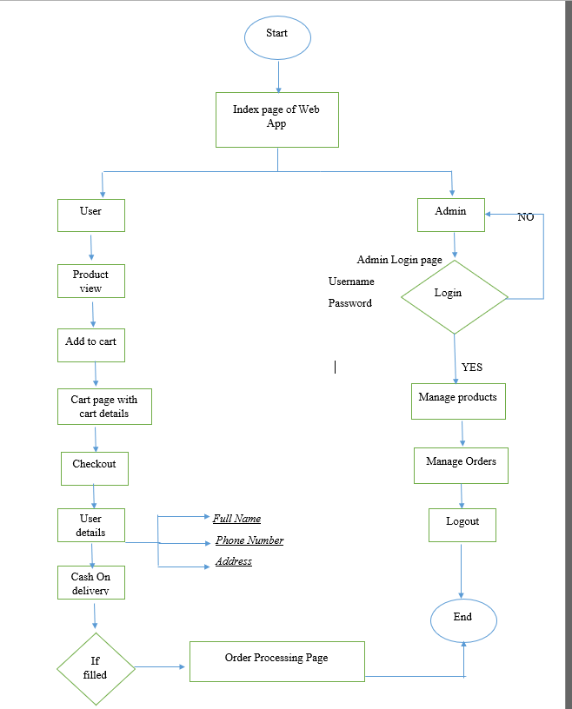
Flow Chart

Slide 6
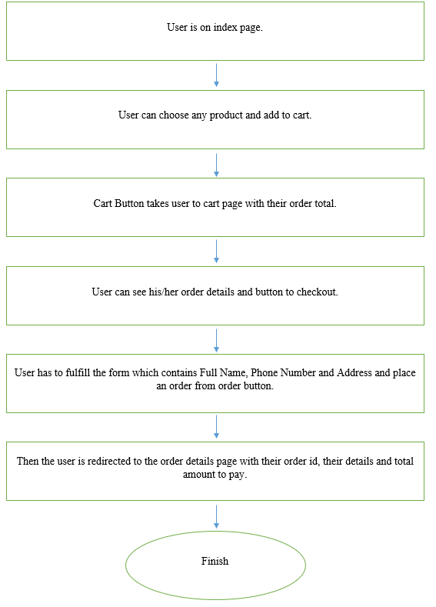
Working Principle

Slide 7
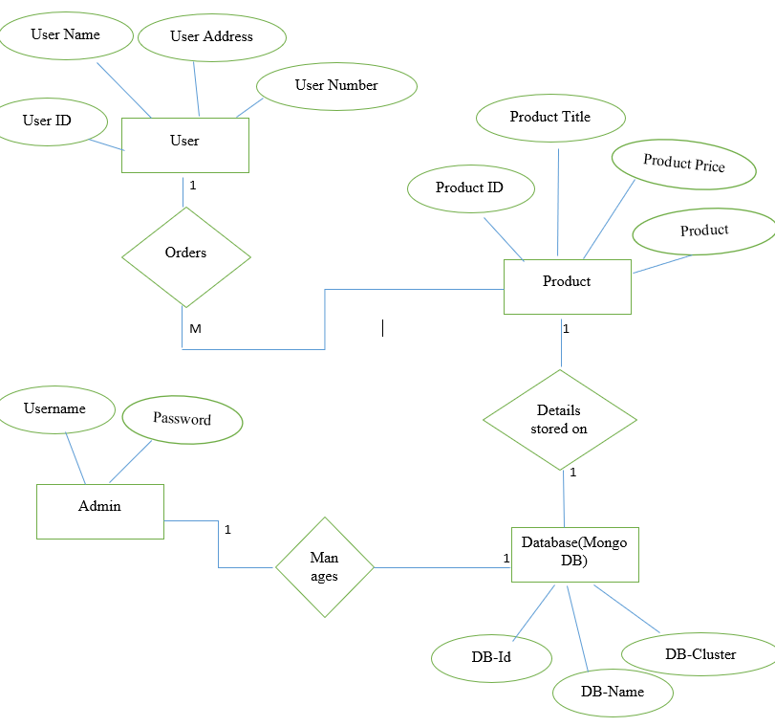
ER Diagram

Slide 8
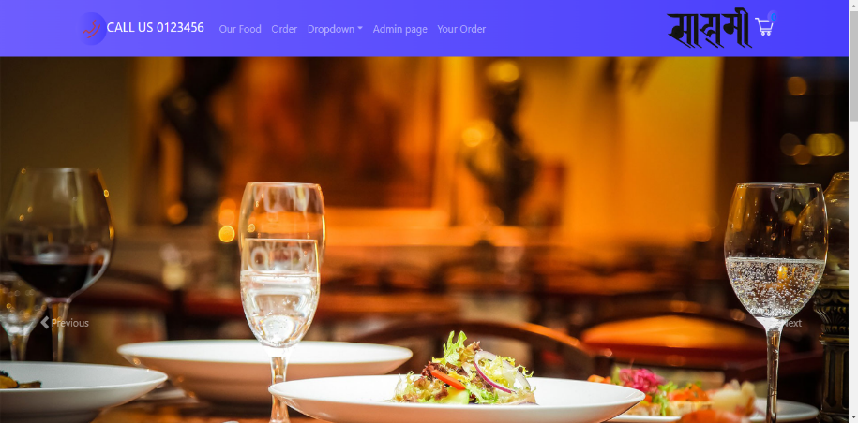
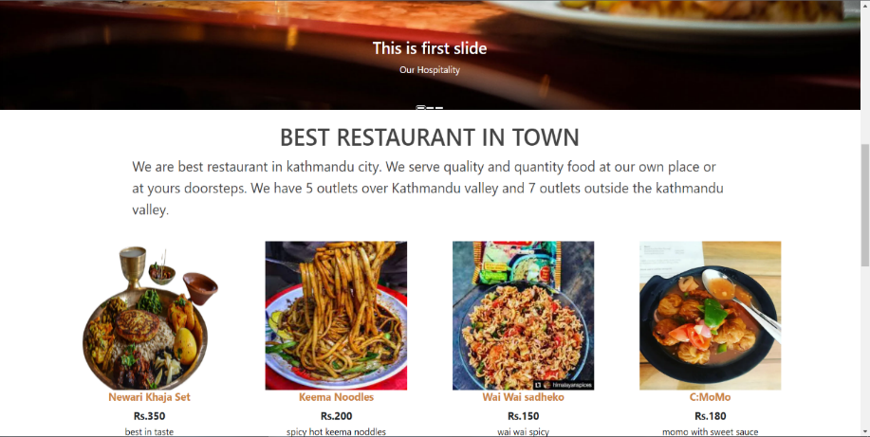
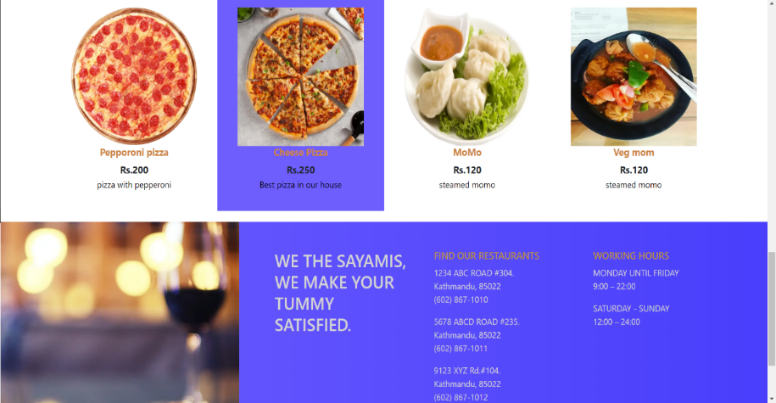
Some preview of our website
Index page

Slide 9
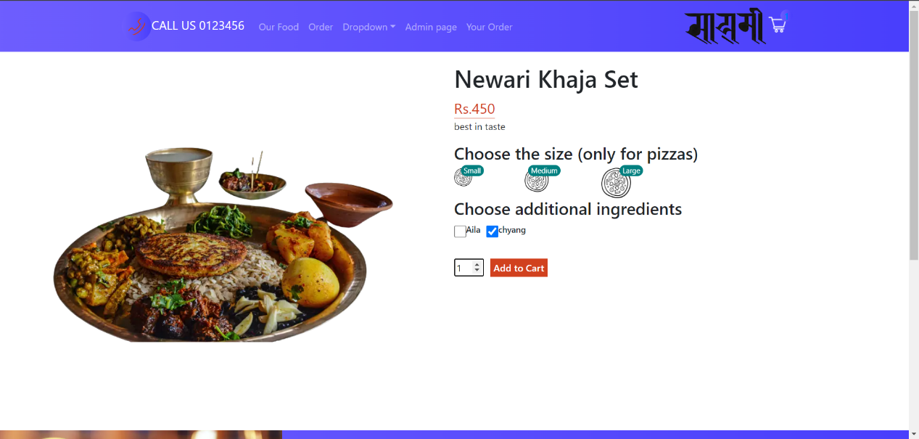
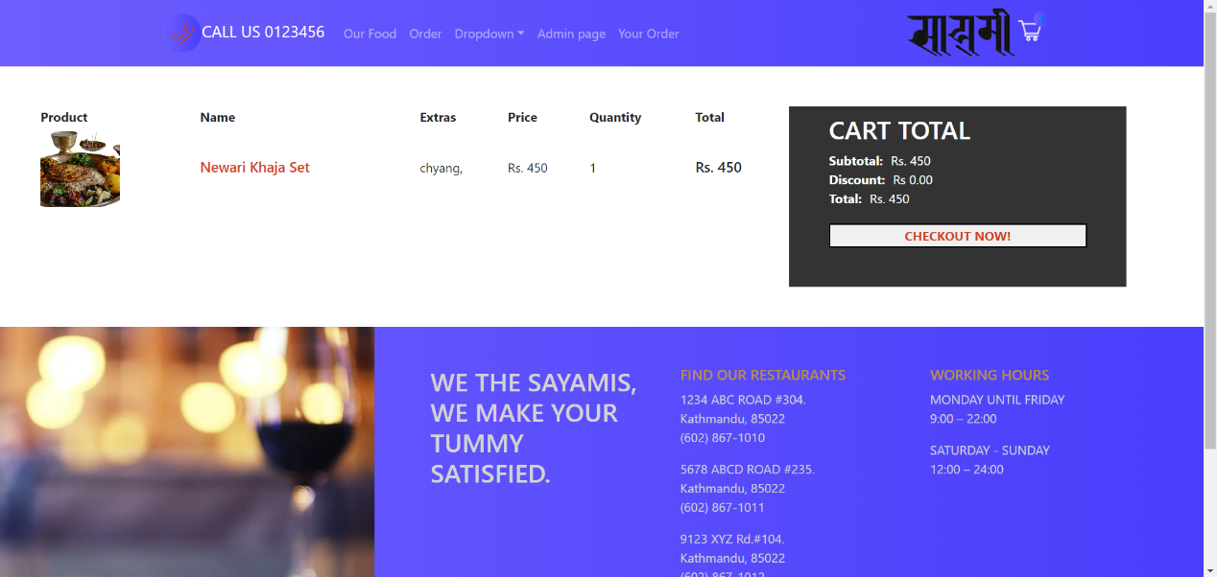
Product Details Page
Cart page

Slide 10
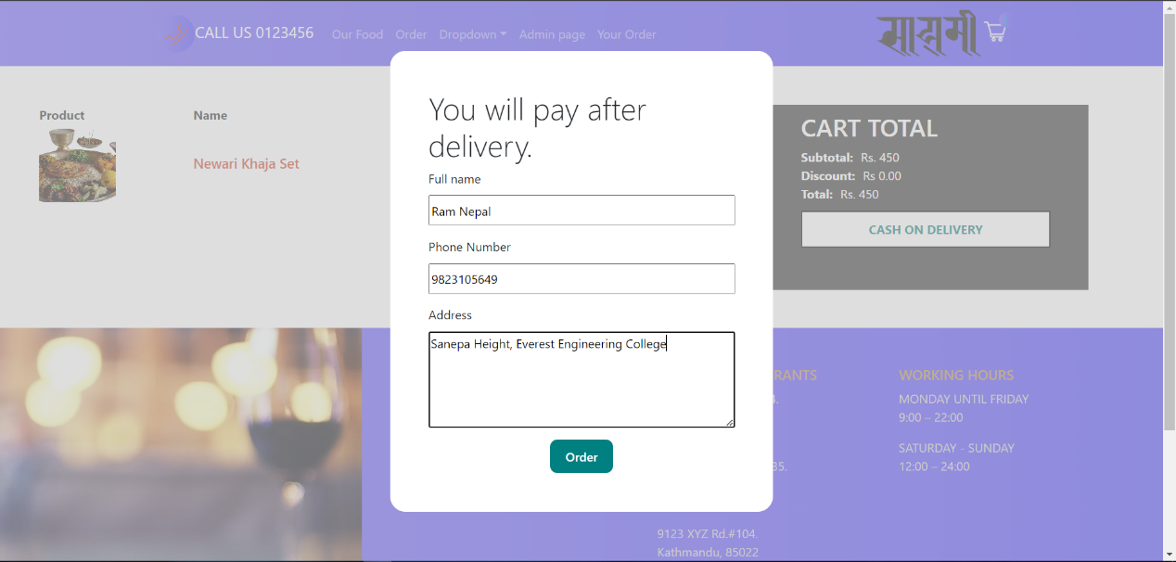
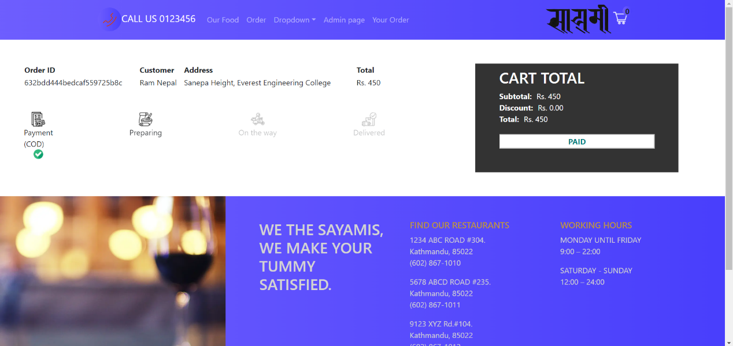
User Details Form
Order Details Page

Slide 11
Thank you
If any queries or criticism related to our project, we’d be happy to answer them now.

